Slide 1
Using MegaStat®
© McGraw Hill LLC. All rights reserved. No reproduction or distribution without the prior written consent of McGraw Hill LLC.

Slide 2

What Is MegaStat?
MegaStat® is an Excel add-in for statistical data analysis and graph creation. It is sold as a web download for Windows 10 or Mac OS-X (Version 11 only). After installation, the MegaStat command will be added to your Excel spreadsheet on the Data ribbon. You may purchase MegaStat® for about $15 (price as of 2016) from McGraw-Hill. Click here for more information.

Slide 3
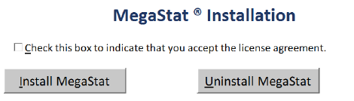
Installing
Click the installation workbook MegaStat Add-In Installer.xlsm. MegaStat.xlam and MegaStat.chm must be in the same folder as the installation workbook. When you open the installation workbook there will be an Install MegaStat button like this:
Click Install MegaStat and the MegaStat files will be copied to the Excel Add-ins folder and MegaStat will be placed on the Add-ins ribbon. Note: When you open the installer workbook you may be asked to click Enable Content. You will need to have macros in Excel enabled to install and run MegaStat.

Slide 4
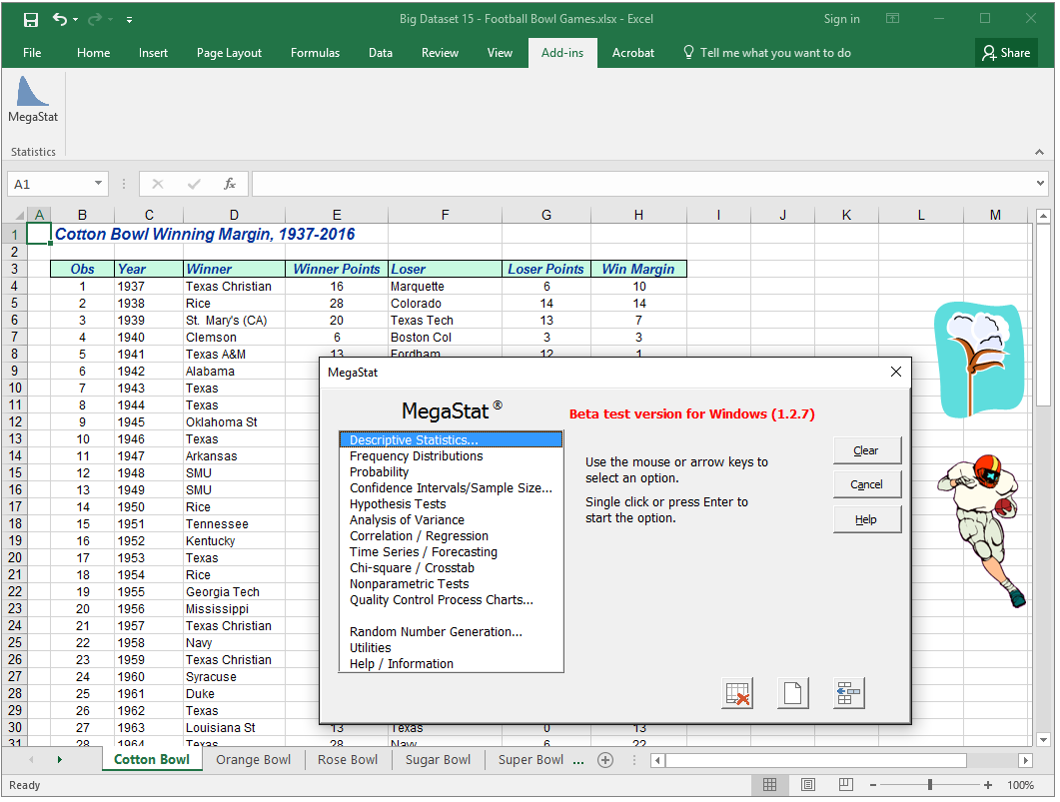
Data Set
Example: Winning margin in the Cotton Bowl from 1937 to 2016.

Slide 5
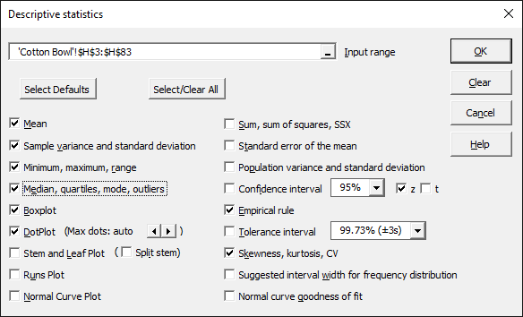
Descriptive Statistics
Choose the outputs that you want.

Slide 6
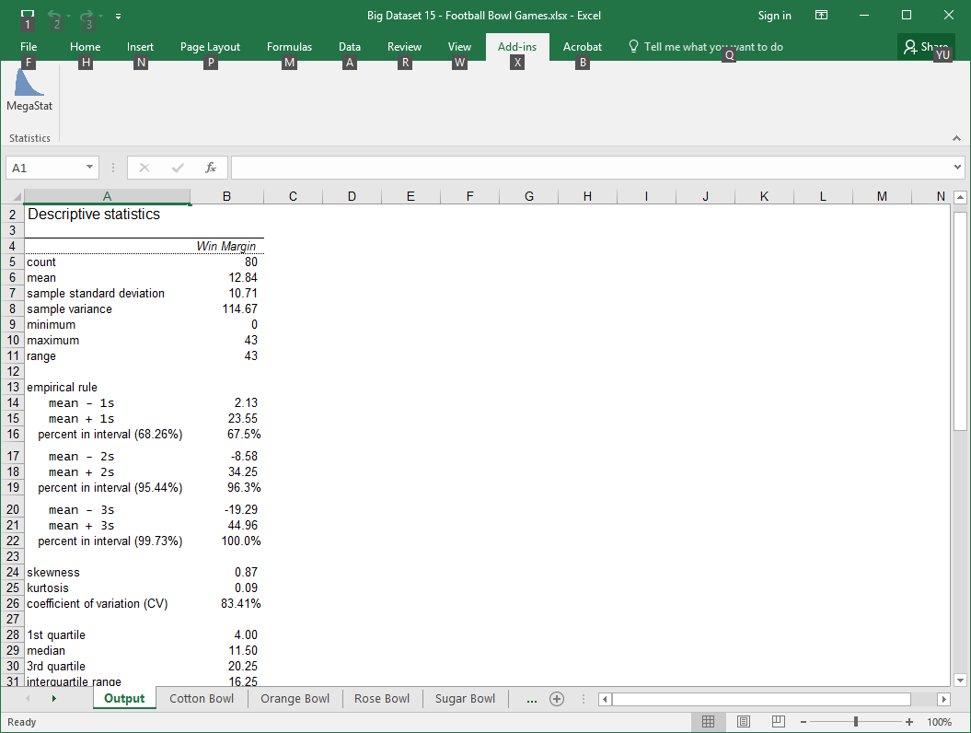
Output Worksheet
Results are displayed on a new worksheet named Output. If you do more statistics, they will be appended at the bottom of the Output worksheet.

Slide 7
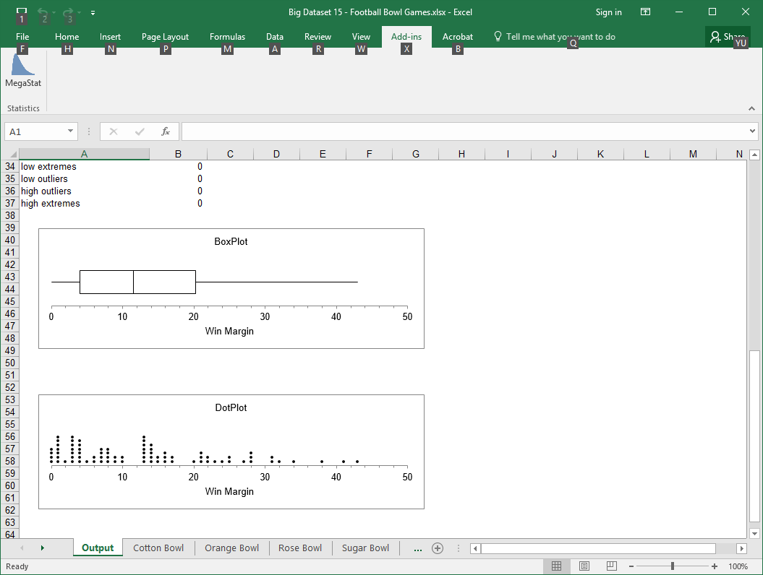
Output Charts
Scroll down to see the charts you have requested (e.g., box plot, dot plot). You can edit axis scales and colors.

Slide 8
Graph Editing
Before
Some graph features can be edited. Or you can choose an Excel template). Be careful to preserve the scaling.
After
This is just to show what Excel can do (not to suggest that this is an improvement).

Slide 9
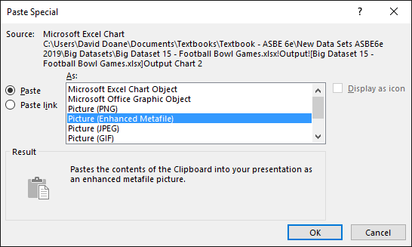

Pasting a Graph
Tip: When you copy an Excel graph to Word or PowerPoint, use Paste Special > Picture. Otherwise, a link may be retained to Excel, which can cause problems later on.

Slide 10
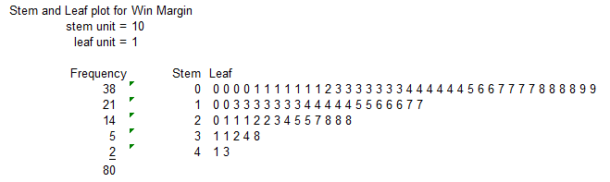
Graphs: Interpretation
Runs plot shows variation in winning margin over time and a possible upward trend.
The stem-and-leaf and box plots show right-skewness. Most Cotton Bowl games are decided by less than 12 points.

Slide 11
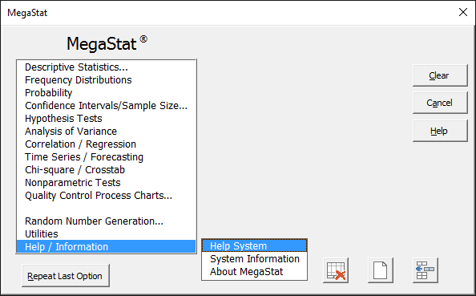
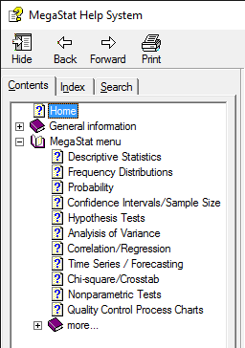
Help System
MegaStat's help system explains how it computes statistics and graphs, along with editing options. You can also check your MegaStat version.

Slide 12

Summary
MegaStat is easy because it's an Excel add-in.
It makes nicely-scaled graphs and rounded statistics.
You can customize its output graphs.
To copy graphs to Word or Powerpoint, use Paste Special.

